Slide 1
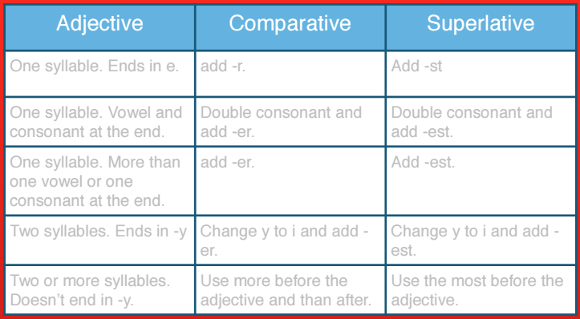
fine
finer
finest
big
bigger
biggest
fast
faster
fastest
happy
happier
happiest
interesting
more interesting
the most interesting

Slide 2
Comparative Small Big Old Young New Fast Slow Smart Silly* Funny* Good** Bad** | Superlative

Slide 3
True or False
A giraffe is shorter than an elephant.
An elephant is bigger than a cat.
Iberdrola is the tallest building in the world.
Niamh is the youngest in the class.
The River Amazon is longer than the River Nile.
Spain is smaller than Ireland.
Russia is the largest country in the world.
Chocolate is better than crisps.
The rain in Basque Country is worse than the rain in Ireland.

Slide 4
True or False
The River Nile is longer than the Nervion.
The cheetah is the slowest animal.
A mouse is bigger than an elephant.
The Guggenheim is newer than the Colosseum.
Europe is larger than America.
A rabbit is faster than a turtle.

